Slide 1

The Internet
Chris Piech
CS106A, Stanford University

Slide 2
I came here to make friends and program the internet...

Slide 3
... And I already made friends.

Slide 5
For the first time ever in CS106A:

Slide 6

Learning Goals
Write a program that can make internet requests
Write a program that can respond to internet requests

Slide 7
How does your phone communicate with facebook?

Slide 8
The Java program on your phone talks to the Java program at Facebook

Slide 9
Face Book Server
* Android phones run Java. So do facebook servers

Slide 10
Face Book Server
Is this legit?
piech@cs.stanford.edu
piech@cs.stanford.edu is now logged in

Slide 11
Face Book Server
Send me the full name for
piech@cs.stanford.edu
Chris Piech
“Chris Piech”

Slide 12
Face Book Server
Send me the cover photo for
piech@cs.stanford.edu
Chris Piech

Slide 13
Face Book Server
Send the profile photo for
piech@cs.stanford.edu
Chris Piech

Slide 14
Face Book Server
Send the status for
piech@cs.stanford.edu
Chris Piech
“chillin”
Status: Chris is chillin
Set status:

Slide 15
Face Book Server
Set the status for
piech@cs.stanford.edu
to be “lecturing”
Chris Piech
“success”
Status: Chris is chillin
Set status:
lecturing

Slide 16
Face Book Server
Send me the status for
piech@cs.stanford.edu
Chris Piech
“lecturing”
Status: Chris is chillin
Status: Chris is lecturing
Set status:

Slide 17
There are two types of internet programs. Servers and Clients

Slide 18
Internet 101

Slide 19
Servers are computers (running code)
Face Book Server
=

Slide 20
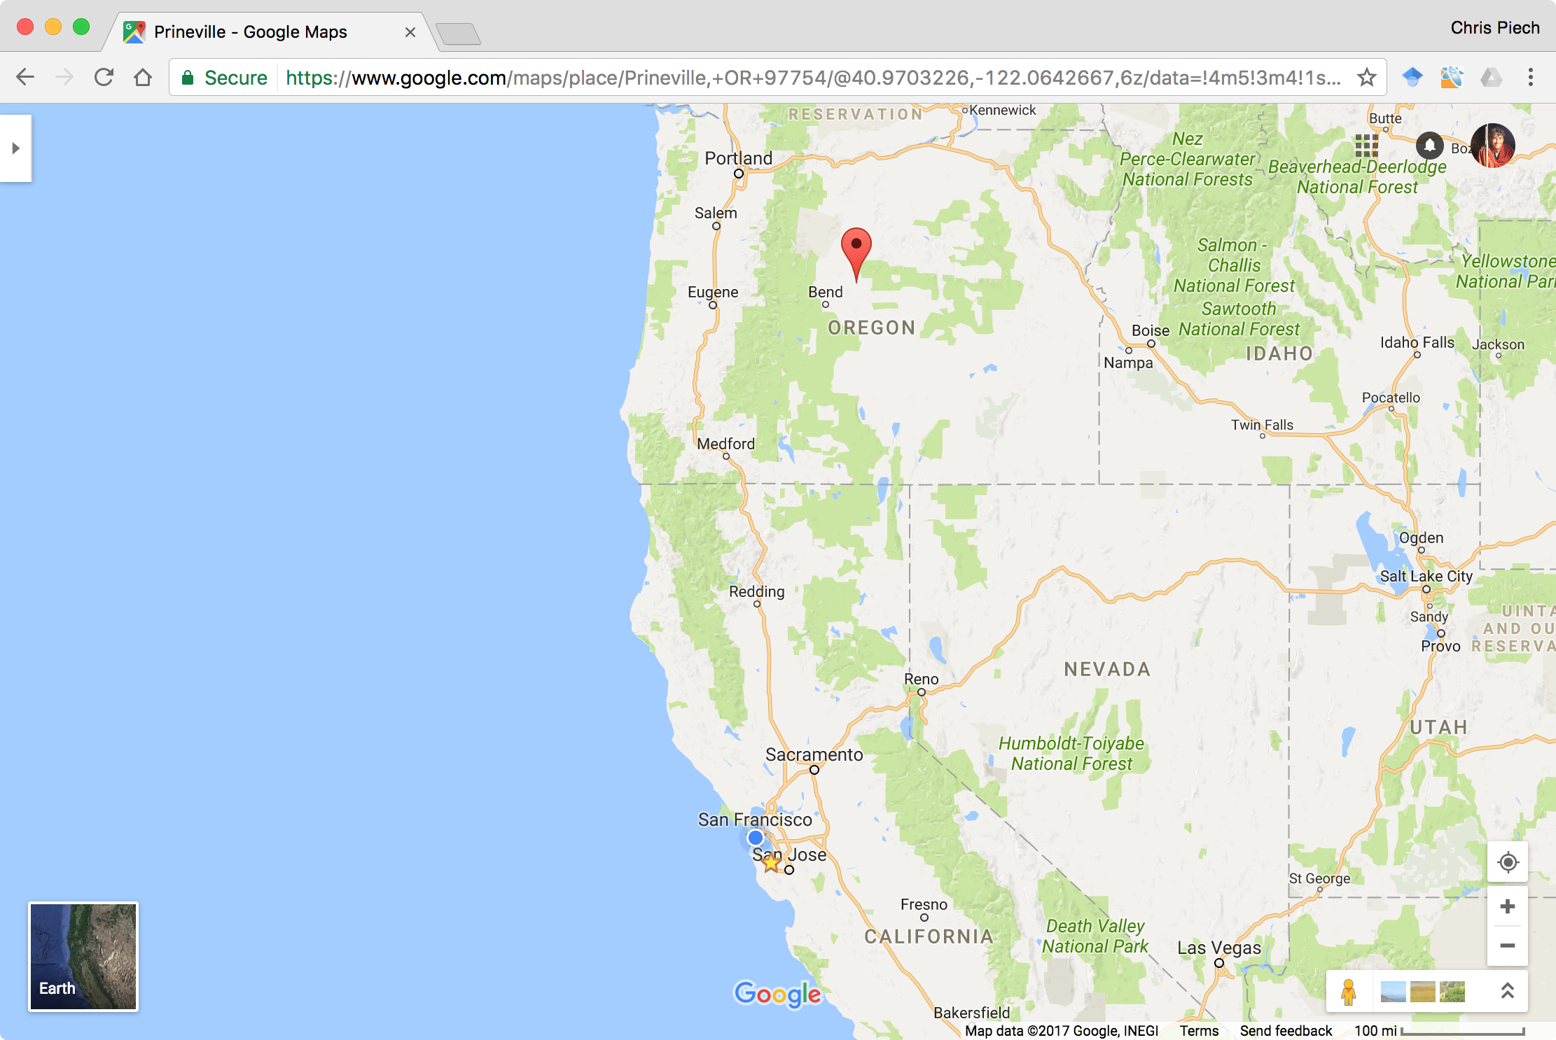
Facebook’s closest datacenter is here
I am here

Slide 21
Face Book Server
The Internet

Slide 22
Face Book Server
The Internet
Get status for piech@cs.stanford.edu

Slide 23
Face Book Server
The Internet

Slide 24
Face Book Server
The Internet

Slide 25
teaching
Face Book Server
The Internet

Slide 26
teaching
Face Book Server
The Internet

Slide 27
teaching
Face Book Server
The Internet

Slide 28
There are two types of internet programs. Servers and Clients

Slide 29
First, the server

Slide 30
A Server’s Simple Purpose
Request
someRequest
String
serverResponse
Server

Slide 31
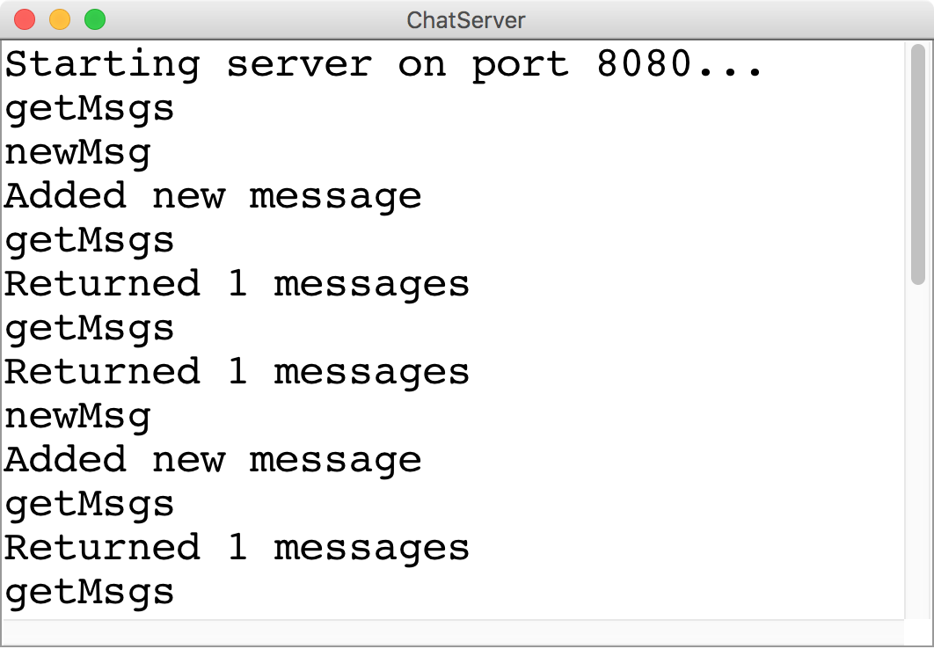
A Server’s Simple Purpose
Request
someRequest
String
serverResponse

Slide 32
Servers on one slide
public String requestMade(Request request) {
// server code goes here
}
1
2
// make a Server object
private SimpleServer server
= new SimpleServer(this, 8000);
3
public void run(){
// start the server
server.start();
}

Slide 33
A Server’s Simple Purpose
public String requestMade(Request request) {
// server code goes here
}
1
2
// make a Server object
private SimpleServer server
= new SimpleServer(this, 8000);
3
public void run(){
// start the server
server.start();
}

Slide 34
What is a Request?
/* Request has a command */
String command;
/* Request has parameters */
HashMap<String,String> params;
Request request
// methods that the server calls on requests
request.getCommand();
request.getParam(key); //returns associated value

Slide 35
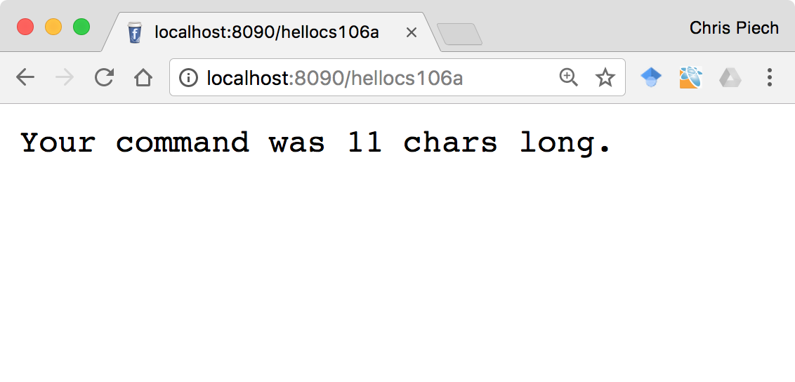
Echo Server

Slide 36
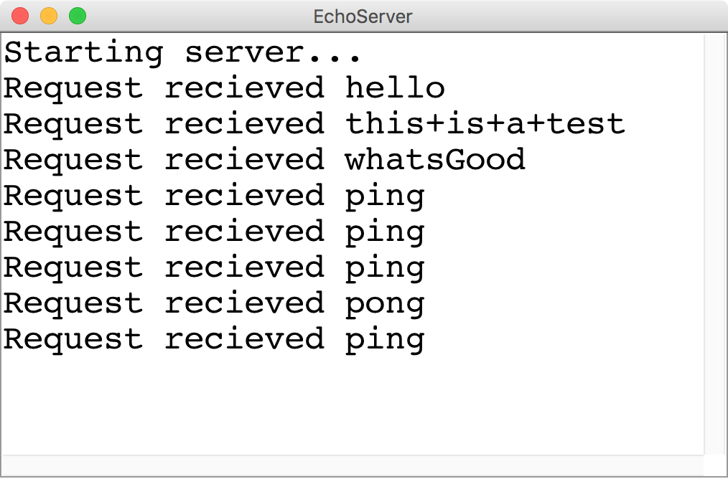
Echo Server
Request
Any Request
String
Length of the cmd

Slide 37
There are two types of internet programs. Servers and Clients

Slide 38
Then, the client

Slide 39
A Clients’s Purpose
1. Interact with the user
2. Get data from its server
3. Save data to its server

Slide 40
Clients on one slide
try {
// 1. construct a new request
Request example = new Request("getStatus");
// 2. add parameters to the request
example.addParam("name", "chris");
// 3. send the request to a computer on the internet
String result = SimpleClient.makeRequest(HOST, example);
} catch(IOException e) {
// The internet is a fast and wild world my friend
}

Slide 41
Clients on one slide
try {
// 1. construct a new request
Request example = new Request("getStatus");
// 2. add parameters to the request
example.addParam("name", "chris");
// 3. send the request to a computer on the internet
String result = SimpleClient.makeRequest(HOST, example);
} catch(IOException e) {
// The internet is a fast and wild world my friend
}

Slide 42
Clients on one slide
try {
// 1. construct a new request
Request example = new Request("getStatus");
// 2. add parameters to the request
example.addParam("name", "chris");
// 3. send the request to a computer on the internet
String result = SimpleClient.makeRequest(HOST, example);
} catch(IOException e) {
// The internet is a fast and wild world my friend
}

Slide 43
Clients on one slide
try {
// 1. construct a new request
Request example = new Request("getStatus");
// 2. add parameters to the request
example.addParam("name", "chris");
// 3. send the request to a computer on the internet
String result = SimpleClient.makeRequest(HOST, example);
} catch(IOException e) {
// The internet is a fast and wild world my friend
}

Slide 44
Clients on one slide
try {
// 1. construct a new request
Request example = new Request("getStatus");
// 2. add parameters to the request
example.addParam("name", "chris");
// 3. send the request to a computer on the internet
String result = SimpleClient.makeRequest(HOST, example);
} catch(IOException e) {
// The internet is a fast and wild world my friend
}

Slide 45
Clients on one slide
try {
// 1. construct a new request
Request example = new Request("getStatus");
// 2. add parameters to the request
example.addParam("name", "chris");
// 3. send the request to a computer on the internet
String result = SimpleClient.makeRequest(HOST, example);
} catch(IOException e) {
// The internet is a fast and wild world my friend
}

Slide 46
Clients on one slide
try {
// 1. construct a new request
Request example = new Request("getStatus");
// 2. add parameters to the request
example.addParam("name", "chris");
// 3. send the request to a computer on the internet
String result = SimpleClient.makeRequest(HOST, example);
} catch(IOException e) {
// The internet is a fast and wild world my friend
}

Slide 47
Clients on one slide
try {
// 1. construct a new request
Request example = new Request("getStatus");
// 2. add parameters to the request
example.addParam("name", "chris");
// 3. send the request to a computer on the internet
String result = SimpleClient.makeRequest(HOST, example);
} catch(IOException e) {
// The internet is a fast and wild world my friend
}

Slide 48
Time for a little chat

Slide 49
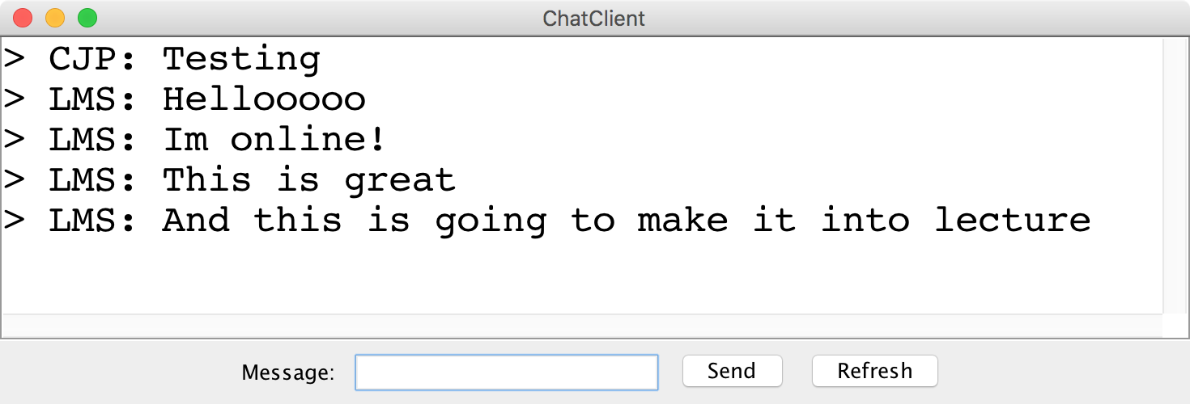
Chat Server and Client

Slide 50
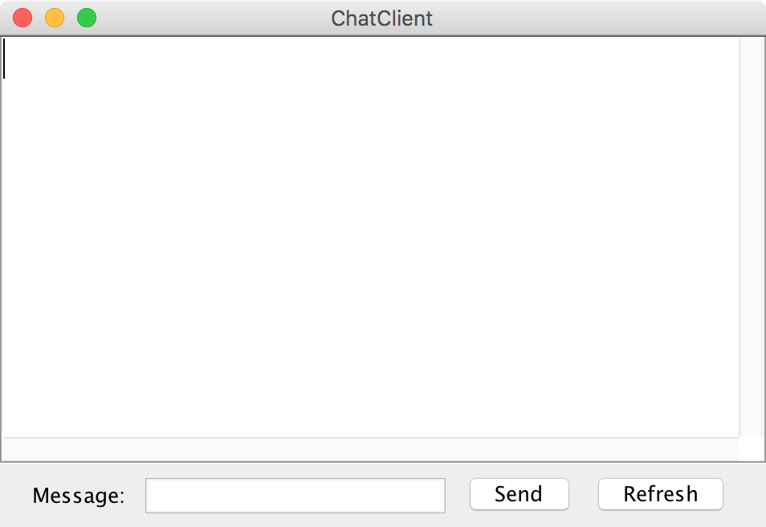
history = [
]
addMsg
msg = Hello world
Chat Client
Chat Client
Send
Hello world
Send

Slide 51
history = [
Hello world
]
getMsgs
index = 0
Chat Client
Chat Client
Send
Send

Slide 52
history = [
Hello world
]
[Hello world]
Chat Client
Chat Client
> Hello world
> Hello world
Send
Send

Slide 53
history = [
Hello world
]
addMsg
msg = Im here too
Chat Client
Chat Client
> Hello world
> Hello world
Im here too
Send
Send

Slide 54
history = [
Hello world,
Im here too
]
getMsgs
index = 1
Chat Client
Chat Client
> Hello world
> Hello world
Send
Send

Slide 55
history = [
Hello world,
Im here too
]
[Im here too]
Chat Client
Chat Client
> Hello world
> Hello world
> Im here too
> Im here too
Send
Send

Slide 56
Chat Server
addMsg
msg = text
Chat Server
getMsgs
index = startIndex

Slide 58
Facebook revisited

Slide 59
Command: getProfileImg
Params:
email=piech@cs.stanford.edu
Face Book Server
Chris Piech

Slide 60
Face Book Server
ab284ual23413.jpg
Chris Piech

Slide 61
Command: getImage
Params:
fileName=ab284ual23413.jpg
Face Book Server
Chris Piech

Slide 62
Face Book Server
Chris Piech

Slide 63
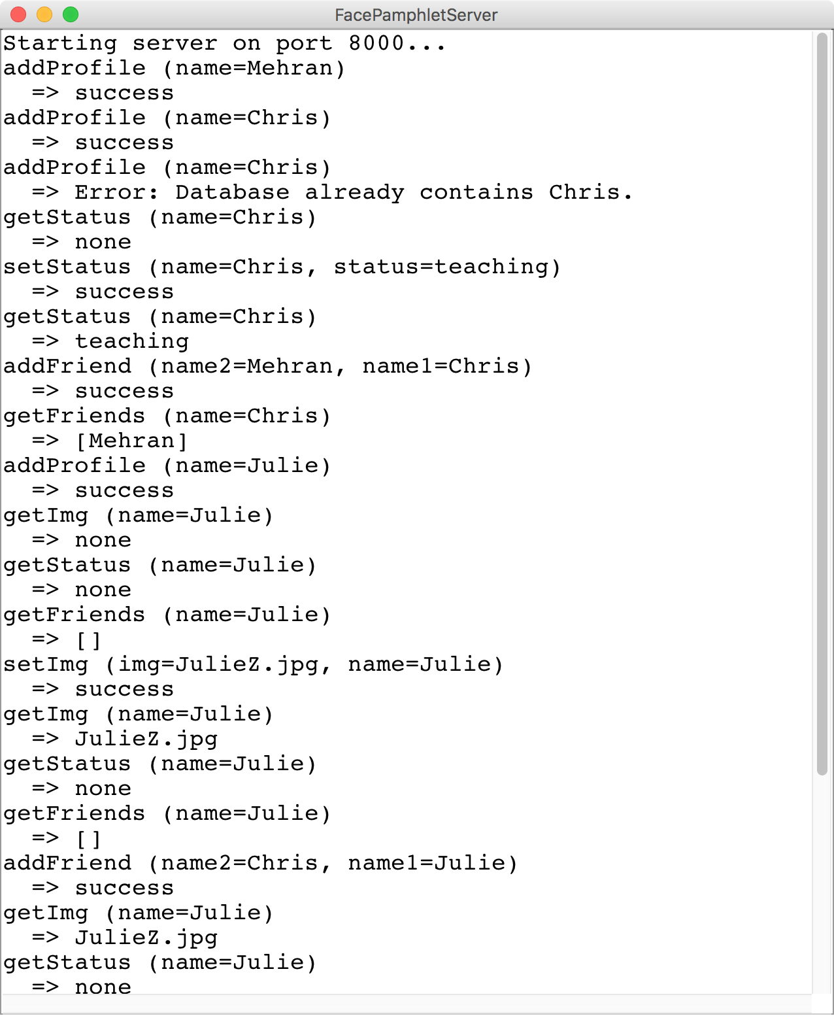
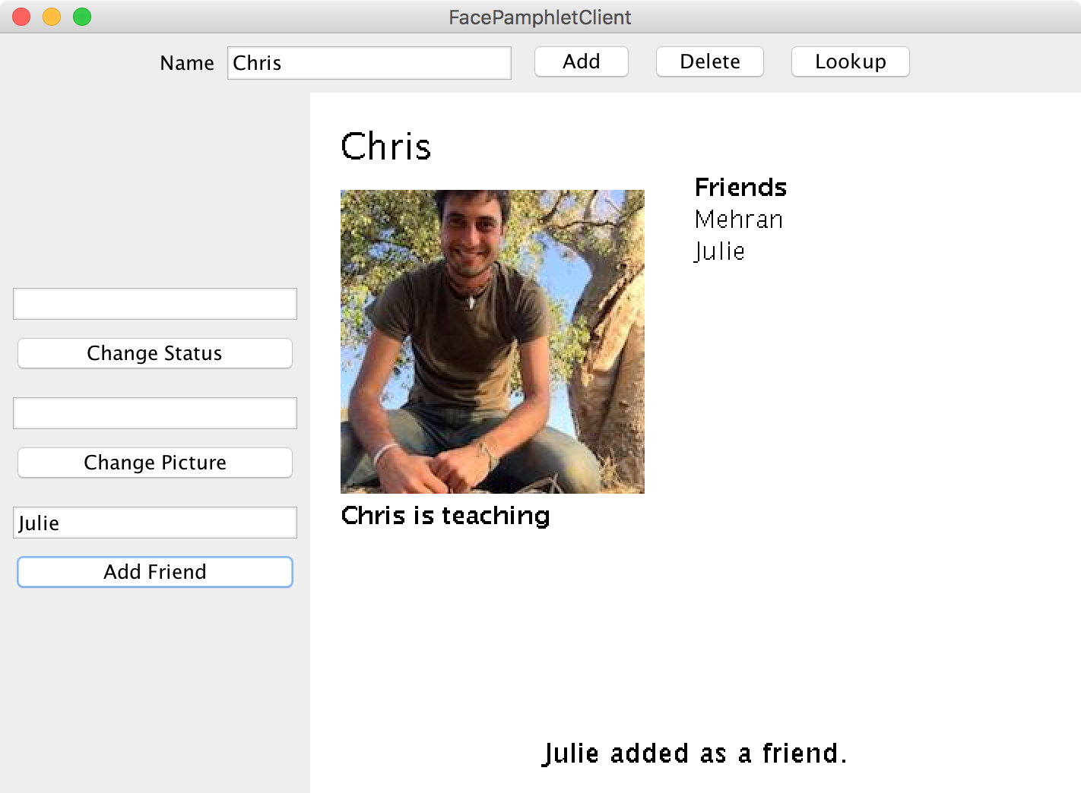
Face Pamphlet
FacePamphletServer
FacePamphletClient

Slide 64
Localhost forever?

Slide 65
Use ngrok to get a url

Slide 66
Want to learn more?
CS144 Computer Networking
Or CS193P
Or CS193A
Or CS108

Slide 67
The end

